Slide 1


DIGITAL REVOLUTION
OF THE
EMPLOYMENT AGENCY OF MONTENEGRO
Building a modern data-driven public employment service
May 2026

Slide 2
INTRODUCTION
The digital transformation of the Employment Agency of Montenegro represents a comprehensive, chronological and strategically structured process focused on THE NEW INFORMA TION SYSTEM, infrastructure modernization, service digitalization and interoperability.
The Agency is transitioning from the digitalization of individual processes toward the transformation of the public employment service into a data-driven, interoperable and user-oriented institution.
The new information system is not an isolated software solution, but the foundation for transforming the operational model — from administration and record-keeping toward active case management and measurable outcomes.

Slide 3
WHY TRANSFORMATION WAS NECESSARY
Before the project, the Agency operated in an environment shaped by fragmented solutions, with multiple disconnected applications, manual processes and limited analytics. The key challenge was not only outdated technology, but the absence of a unified system capable of connecting processes and data.
The Agency did not need only technical modernization, but a unified digital platform that integrates processes, data and enables further development.

Slide 4
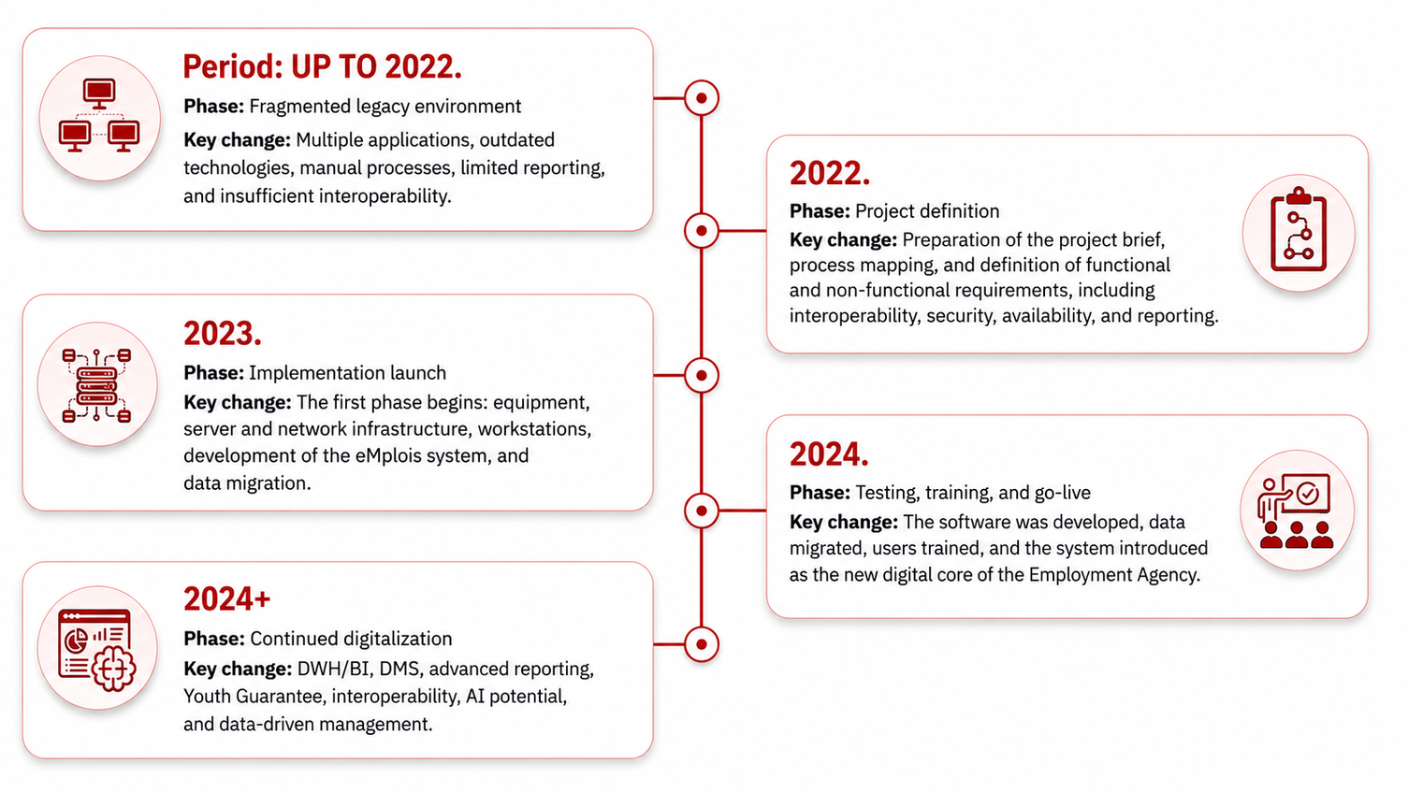
TRANSFORMATION TIMELINE
2023. godina

Slide 5
PROJECT FRAMEWORK
“Upgrade of IT Infrastructure and Development of the New Information System” is being implemented through EU funds with co-financing from the Government of Montenegro.
The project is part of a broader policy framework focused on:
• employment,
• social inclusion,
• digital public administration.
It encompasses three key segments:
• infrastructure (servers, network, DR),
• end-user equipment,
• development of the eMplois system.

Slide 6
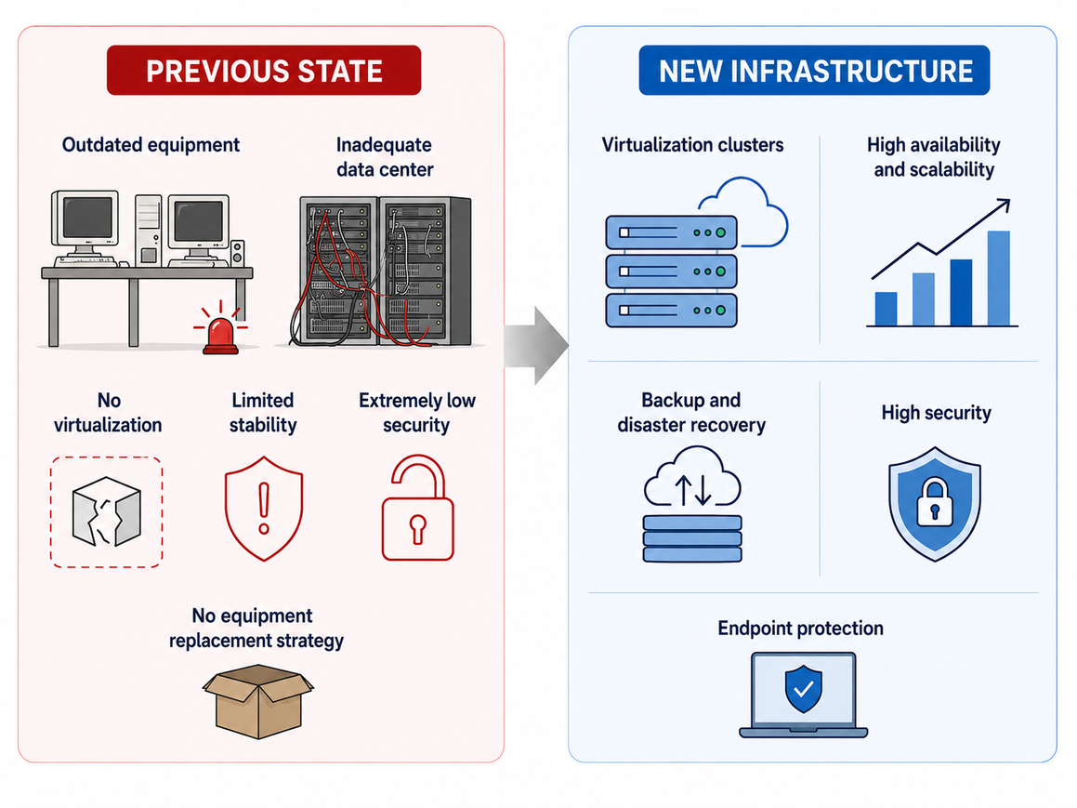
INFRASTRUCTURE
Infrastructure as the foundation of a stable information system

Slide 7
eMPLOIS AS THE DIGITAL CORE
eMplois represents the central digital platform of the Agency.
It integrates processes into a unified database.
Introduces a modular approach.
Connects users, processes and data.
It covers all key business processes of the Agency (employment mediation, records management, work with unemployed persons and employers, finance, active labour market measures, etc.).
The most significant transformation: the shift from administrative tasks to an integrated service workflow.

Slide 8
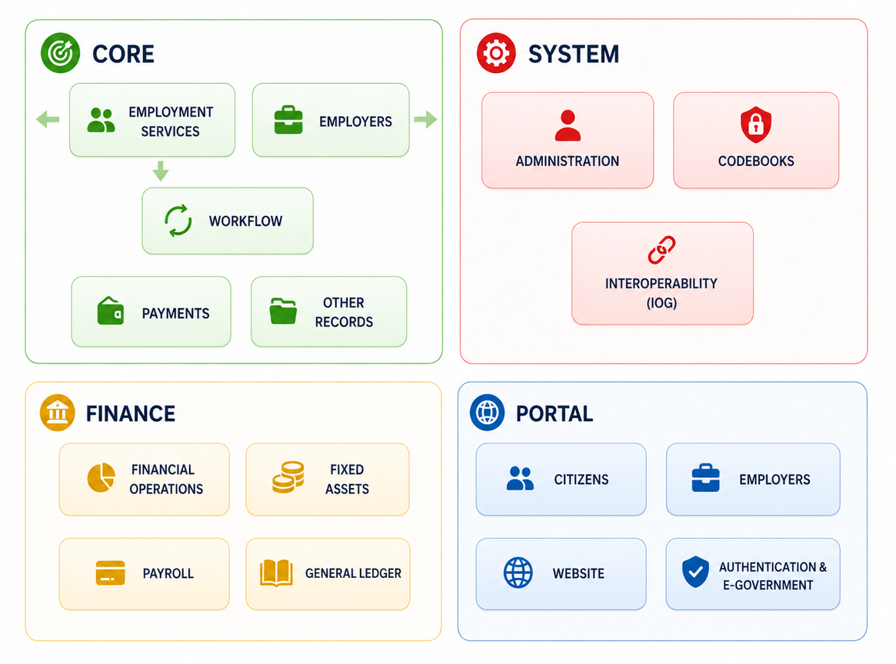
eMPLOIS AS THE DIGITAL CORE

Slide 9
Shifting the focus from office-based procedures to user experience.
UNEMPLOYED PERSONS: faster access to Agency services, online registration, access to information, interaction with counselors, employment mediation, access to rights, and application for programs or grants.
BUSINESS SECTOR: vacancy registration, application for subsidies, programs and grants, personalized profiles, and faster communication with the Agency.
EMPLOYEES: reduced time spent on repetitive administrative tasks. The system performs validations, checks and standardized workflows, allowing employees to focus more on individual user support, needs assessment, counseling, guidance toward measures and employment mediation.

Slide 10
INTEROPERABILITY as a key pillar of transformation
The project specification identified interoperability as a mandatory requirement of the future system. This means that the system was not designed solely as an internal Agency application, but as part of a broader public administration ecosystem. Integration with relevant registries enables more up-to-date data, fewer errors, faster decision-making and reduced administrative burden for both citizens and employees.

Slide 11
EURES
The system is designed as a modular and interoperable platform, ready for integration with European services such as EURES without requiring fundamental architectural changes. Its flexibility and scalability enable rapid adaptation to new functionalities, standards and increasing data volumes, while maintaining stability and performance. In this way the Agency is not implementing only a solution for today but building a digital foundation prepared for future European integrations and unrestricted system growth.

Slide 12
CONTINUATION OF DIGITALIZATION
Analytics is becoming the new infrastructure for decision-making.
A document is no longer paper — a document is a process.
AI is not the future. AI is the next step.

Slide 13
BENEFITS
USERS
Faster simpler and digitally accessible services, with more active participation in the employment process.
EMPLOYERS
More efficient access to candidates, programs and digital communication with the Agency.
EMPLOYEES
Less administration and routine work, with more focus on counseling, mediation and higher-quality decision-making.
ST A TE
Reliable data, interoperability and a data-driven foundation for modern employment policies.

Slide 14
“AI” AS A NATURAL CONTINUATION OF DEVELOPMENT
Smart matching of users and job vacancies
Prediction of long-term unemployment risks
Recommendation of measures and training programs based on user profiles and labour market needs
Support for counselors through history analysis and recommendation of next steps
Intelligent document processing and anomaly detection in data
“AI” is not a trend, but a logical continuation of digital transformation aimed at faster analysis, higher-quality decision-making and more efficient user guidance.

Slide 15
CONCLUSION
The digital transformation of the Employment Agency of Montenegro represents a multi-phase process that began with addressing inherited technological and organizational limitations, continued through infrastructure modernization and the development of the eMplois system, and is now entering the phase of advanced analytics, document management, interoperability and future AI implementation.
EAM is evolving from an administrative service into an intelligent, interoperable and data-driven platform that actively manages users pathways to employment and makes decisions based on real outcomes. Digital transformation is not the final goal, but a strategic instrument for building a modern public employment service prepared for European standards, future technologies and measurable impact on the labour market.

Slide 16
THANK YOU
FOR YOUR ATTENTION!
Luka Đuričković
DEPUTY DIRECTOR
luka.djurickovic@zzzcg.me

